Slide 1

中考复习指导词法篇：情态动词
主讲教师：张月
天津市第四中学

Slide 2
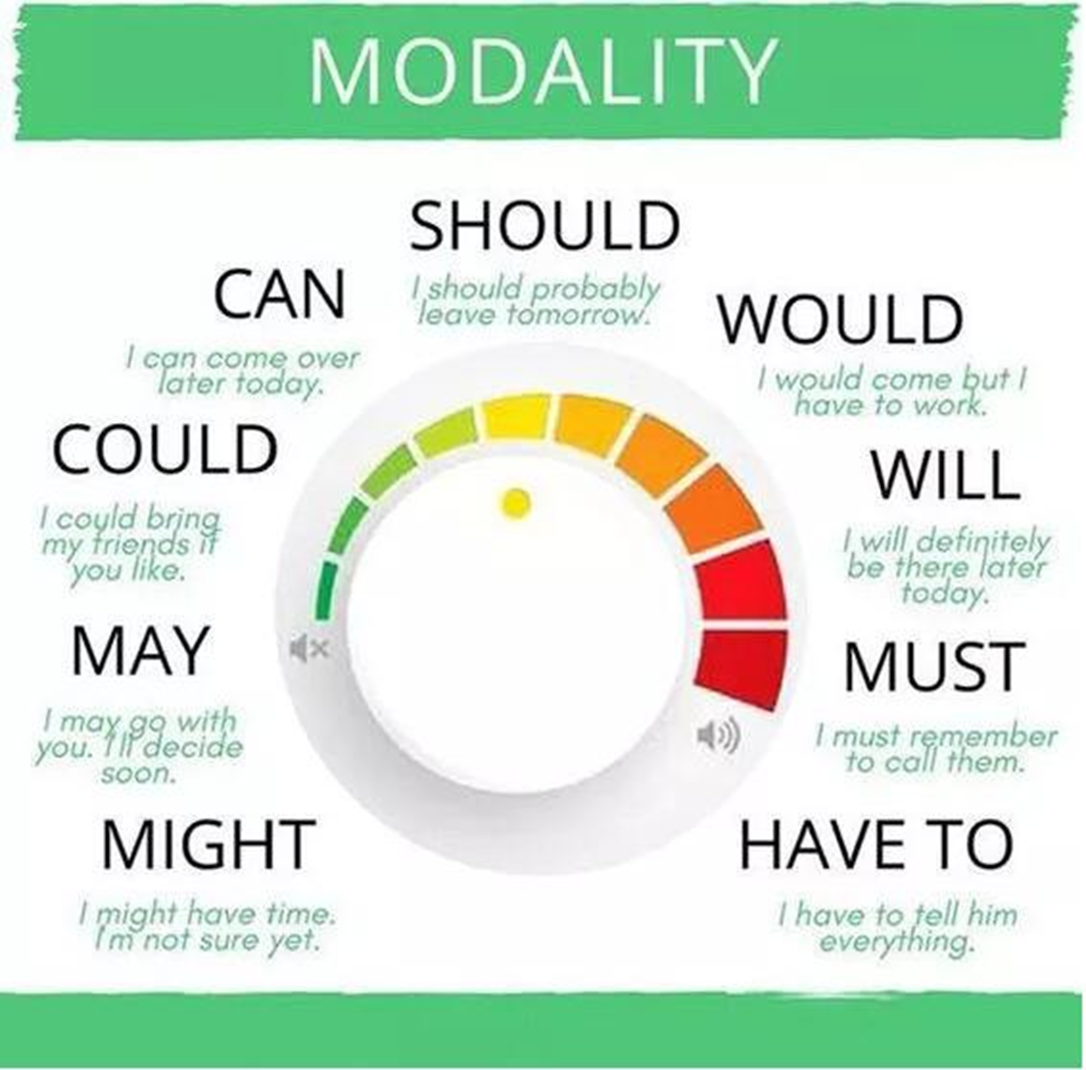
学过的主要情态动词
MODAL Verbs

Slide 3

情态动词特征
情态动词的词义及基本用法
中考真题解析
典型例题分析
总结

Slide 4


情态动词特征
情态动词有五个特征：
①情态动词本身有词义,表示说话人的语气或态度。
所表示的语气或态度有: 命令、允许、请求、拒绝、
愿望、愿意、义务、必要、可能、敢于、需要等；
②不能单独做谓语，必须与其他动词一起构成谓语；
③没有人称和数的变化；
④情态动词后必须跟动词原形；
⑤具有助动词功能。

Slide 5

情态动词的词义及基本用法
can / can not
1. 表示能力 (会)
1) Mary can speak English, but she can not speak French.
2) Can you lift this heavy box?
2. 表示允许 (可以)
1）Can I use your dictionary?
2）—Can I go home now?
—Yes, you can. / No, you can’t.
3.表示推测，意为“可能”，常用于否定句和疑问句，
此时can’t不是“不能”而是“不可能”。

Slide 6
肯定句 ： The news is true. 这消息是真的。
一般疑问句：→ Is the news true? 这消息是真的吗？
表推测、怀疑：→ Can the news be true?
这个消息会是真的吗？
例句：—Can it be our teacher?
那个人有可能是我们老师吗？
—No, it can’t be our teacher. He is visiting the
Great Wall.
不可能。咱们老师正在游览长城呢。

Slide 7

could
1) can的过去式，意为“能、会”，表示过去的能力。
例句：He could write poems when he was 10.
他十岁时就会写诗。
could在疑问句中，表示委婉客气的语气，此时could没有过去式的意思。
例句：①Could you give me a hand? 你能帮我个忙吗？
② — Could I use your pen?
我能用一下你的钢笔吗?
— Yes, you can.可以。

Slide 8
may
1. 表示请求、许可，比can正式。
例句：May I come in? 我可以进来吗？
例句：You may go home now. 现在你可以回家了。
2.表示推测，谈论可能性，意为“可能，或许”，
一般用于肯定句中。
例句：It may rain tomorrow .明天可能会下雨。
例句：She may be at home.她可能在家呢。

Slide 9
might
might，表示推测，可能性较小，
可能性低于may。
He is away from school. He might be sick.
他离开学校了,可能是他生病了。

Slide 10

—Must I hand in my homework right now?
—Yes, you must.
是的， 你必须立刻交作业
—No, you needn’t./ No, you don’t have to.
不，你不必

Slide 11
must/mustn’t
  1. must表示主观看法、命令，意为“必须、一定”。
You must stay here until I come back.
在我回来之前你必须呆在这儿。
Must I hand in my homework right now?
我必须现在交作业吗？
  2. 否定形式mustn’t表示 “禁止，不准，
  不允许”、 “一定不要”、“千万别”。
You mustn’t play with fire. 你不许玩火。
You mustn’t be late.你一定不要迟到。

Slide 12
  must/can’t
3.must表示非常有把握的推测，“肯定”，用于肯定句。
The light is on, so he must be at home now.
灯亮着，他现在肯定在家。
4. can’t表示非常有把握的否定推测，意为“不可能”,
必用在否定句中。
— The man can’t be Mr. Green.
He has gone to America.

Slide 13
should
should表示“应该”，常用来表示劝告、建议；认为“某人应该做某事”或“有义务责任做某事”。
We should obey traffic rules.
You shouldn’t watch TV every day.
这时它可以和 ought to， be supposed to 互换
使用。

Slide 14

ought to， be supposed to
You ought to go and see Mary sometime.
你应该什么时候去看看玛丽。
People ought to drink eight glasses of water daily.
人们应该每天喝八杯水。
You are supposed to finish your homework on time.
你应该按时完成你的作业。
We are supposed to arrive there at six.
我们应该在六点钟到达那里。

Slide 15
need
need作情态动词无人称或数的变化， 后接动词原形，主要用于否定句和疑问句中。
如：You needn‘t worry.你不必担心。
如： —Need I do it now?
— Yes, you ________.
— No, you _______________________ .
need作行为动词，有人称、数和时态的变化,
后接to do， 即 need to do sth
must
needn’t/don’t have to

Slide 16

will/would
1表示意志或意愿：决心，愿意，……
We will do our best to save the child.
我们会尽力抢救这个孩子。
I told her to stop crying, but she just wouldn’t listen.
我叫她别哭,可她就是不愿听。

Slide 17
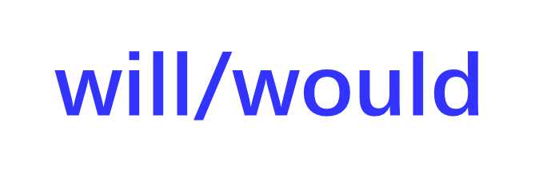
2. 表示请求、建议或征求对方意见时，用
Would you…? 比用Will you…?更婉转。
Will/Would you please keep the door open?
请让门开着好吗？
Will/Would you go with me?
你愿意和我一起去吗?

Slide 18
would相关情态动词
would like表示愿意、想要
I would like to have a word with you.
我想同你说句话
would rather…than…宁愿……也不愿……
I would rather fail than cheat in the exam.
我宁愿考不及格，也不愿意考试作弊。

Slide 19
shall
shall表示征求对方意见（多用于第一、三人称）。
例句：Shall we go out for a walk?
我们出去散步好吗？
其回答方式有以下几种：Yes, please.
All right.
No, thank you.

Slide 20
had better
had better意为“最好做某事”,后接动词原形
其否定形式为：had better not do
We had better go now.
我们最好现在就走。
You had better not tell him the news .
你最好不要告诉他这个信息。

Slide 21
have to
表示客观上需要做的事情， 意为“必须、不得不”。
If I buy that car, l have to borrow some money.
如果我要买那辆汽车,我不得不借些钱。
My brother was very ill, so I had to call the doctor in the middle of the night.
我弟弟病得很厉害，我只得半夜里把医生请来。
(客观上需要做这件事)

Slide 22
must与 have to的区别
1.must 侧重于说话者的主观看法，认为有必要做某事；
have to 则重于客观需要，含有不得不或被迫之意。
2.have to有人称、数、时态的变化，而must只有一种
形式。
He has to work on the farm all day.
We didn't have to wear a uniform at school.
3 . 否定式的意义不同

Slide 23
must 的否定式 mustn’t 意为一定不要、不允许
have to 的否定式 don’t have to 意为不必
（=needn’t）
You mustn’t tell him about it.
你一定不要告诉他这件事。（可能是秘密）
You don’t have to tell him about it.
你不必告诉他这件事。（他可能知道了）

Slide 24
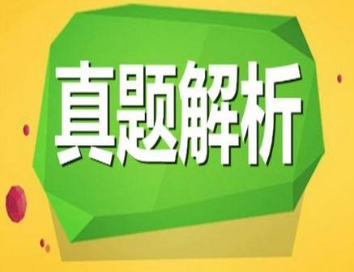

Slide 25

天津中考题
2019
You _______walk on the wet hill path
because you ______ fall and hurt yourself．
A. must； might not B. mustn’t； might
C. needn’t； need D. must； must

Slide 26

2018年
—Must I come before 6: 30 tomorrow?
—No. You______. There will be plenty
of time.
A. mustn’t B. can’t
C. couldn’t D. needn’t
---Must I come before 6: 30 tomorrow? ---No. You______ There will be plenty of time.
A. mustn’t B. can’t C. couldn’t D. needn’t
2017年
When you are travelling，bring a map because it _______ help you．
A．can't B．mustn't
C．used to D．may

Slide 27

1）used to do过去经常，以前常常(现在不做了)
2）be used to doing习惯于做某事
3）be used to do sth.被用来做…
We used to go there every year. 我每年都去那儿。
He is not what he used to be. 他已不是旧日的他了。
He’s quite used to working hard 他颇习惯于艰苦工作。
He is used to living in the country now.
他现在习惯了住在农村。
Wood is used to make paper.木材被用来造纸。
This knife can be used to cut things.
这把刀能够被用于切东西。

Slide 28


I used to drink tea.
我以前喝茶。
I am used to drinking tea.
我习惯于喝茶。

Slide 29
2016—Mum, _____ I play football this afternoon?
—Sure, but you________ finish your homework
first.
A. may; could B. can; must
C. can; mustn’t D. may; can’t
2015 —Is that man Mr Smith?
—It _______ be him. He has gone to
New York on business.
A．may not B．needn't
C．can't D．mustn't

Slide 30

Practice makes perfect

Slide 31

1 —Where's Mr. Li ? I have something
important to tell him.
—You ____ find him. He ______ Japan.
A. may not, has gone to
B. may not, has been to 
C. can‘t， has gone to
D. can't, has been to

Slide 32
2. —Could I look at your pictures?
—Yes, of course you _________.
A. could B. can
C. will D. might
3.These books _________ out of the reading room.
You have to read them here.
A. can't take
B. must be taken
C. can take
D. mustn't be taken

Slide 33
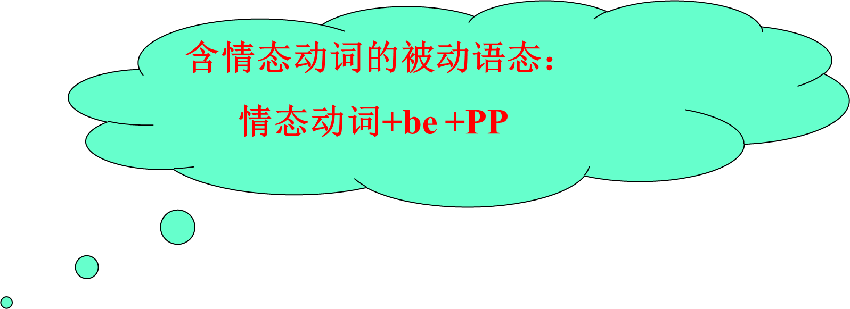
can/could be done
must be done
should be done
may/might be done
had better be done
have to be done

Slide 34

They must water trees every day.
Trees must be watered by them every day.
Trees mustn’t be watered by them every day
Must trees be watered by them every day?

Slide 35
4. Even the top students in our class can't work
out this problem, so it___ be very difficult.
A. may B. must C. can D. need
5. —Hurry up. Mom! The bus is coming.
—Wait a minute, dear. You ____ cross the
road until the traffic lights turn green.
A. must B. need C.needn’t D. mustn’t

Slide 36
John___ come to see us tonight, but he isn't very sure yet.
A. may B. can C. has to D. must
7. He had to give up the plan, ___ he?
did B. didn't
C. does D. hadn't

Slide 37
8.You'd better ___ your hair ___ once a month.
A. had; cut B. had; cuts
C. have; cut D. have; cutting
9. ____ we set off now?
A. Shall B. Might
C. Would D. Ought

Slide 38

10.— Would you like to go swimming with me
this afternoon?
— I'd love to. But I'm afraid I_____. I have too
much work to do.
A. can't
B. mustn't
C. needn't
D. may not

Slide 39
Choose may, must, can’t to fill in the blanks
must
1.The storybook______ be hers. It has her
name on it.
2.The beautiful trousers ______ be Lily’s.
Because they’re too long.
3.The volleyball_______ be Sally’s or Ann’s.
They both like playing volleyball.
can’t
may

Slide 40

情态动词must, may, might, can’t 表示推测
may, might 有可能，也许（20%~80%的可能性）
can’t 不可能，不会（可能性几乎为零）

Slide 41


